Slide 1

BUS MANAGEMENT SYSTEM
Guided by :
Submitted by :
Keshav Thakur,0827IT151053
Abhishek Patel,0827IT151001
Gourav Goswami,0827IT151036
Harshit Mehta,0827IT151040
Islamuddin Shaik,0827IT151047
Himanshu Verma,0827IT151045
Dr. Dinesh Jain

Slide 2
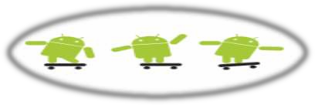
Introduction
“Bus Tracking Application” is an application for Smart phones that works on Android Operating system.
This application uses the GPS function.
This application at a specific pickup point will send the current location of the bus to students when they request.
This app generate predictions of bus arrivals at stops along the route.
This application uses a variety of technologies to track

Slide 3
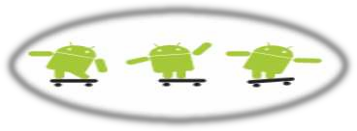
Problem Faced
In the daily operation of bus transport systems, mainly that of buses, the movement of vehicles is affected by different uncertain conditions as the day progresses, such as :
traffic congestion
unexpected delays
Irregular vehicle-dispatching times
other incidents.
Many students are late for classes because they decide to wait for the bus instead of just simply using a alternate transportation.

Slide 4
Solution by Our Application
Our application focus on to providing them more convenience with bus schedules.
It provide Real-time bus location information so that they may not get delayed.
Also we have integrated Google Maps in the application.
2

Slide 5
Development Environment
The proposed system requires Eclipse that is an open source software development environment.
Eclipse consists of an Extensible plugin system and an IDE.
The Android project has been developed in the LUNA version of Eclipse, as it has plugins that are mainly used for Android
LUNA is latest version of Eclipse.

Slide 6
ANDROID SDK
Integrated Development Environment (IDE) is used in Android development in order to make it more straight forward and quick.
It has been recommended for the developers because of its simplicity in working.
Android is basically a multitasking platform.
These applications can work simultaneously with other applications because of multitasking ability of the Android platform.

Slide 7
ADT Plugin
ADT (Android Development Tools) is a plugin developed by Google.
Its main purpose is for developing Android mobile applications in Eclipse.
It makes it easy and convenient for all the Android developers working in Eclipse environment to quickly create Android projects and debug the programs whenever needed.

Slide 8

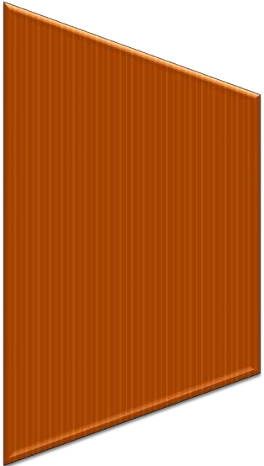

Project Modules
Location Information
Bus/Route Information
Map

Slide 9
Module 1- Location Info
This module depicts the process of selection of Bus no and presenting the current location of the Bus.
TECHNOLOGY APPLIED:
GPS – Global Positioning System.
Client-Server Technology.

Slide 10
GPS- Global Positioning System
It is a technology where satellites send down radio signals which GPS units and receivers use to work out their current location (which is shown by latitude, longitude and elevation).
GPS works like this:
◉ There are 24 working satellites circling the globe at any given moment. A GPS navigator or GPS tracker searches for the transmission signal from at least three satellites

Slide 11
Client- Server working
1
Client will ask for the location of the bus through his android device. Request to the Server is made automatically.
2
Bus is equipped with GPS device.
Through GPS it will find its location and deliver it to Server.
Server will handle the locations and deliver it to the intended client.
3

Slide 12
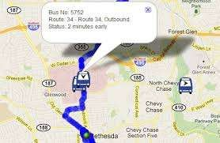
Module 2- Maps
In this Module; application is using Google-APIS to show the Maps.

Slide 13
Module 3 - Bus/Route Information
The Routes of all Buses are recorded by Bus In- charge of college.
For this purpose we have used MySql.
Bus In-charge will update all info regarding routes.
Now when client makes request for the Bus Information it will be fetched from the database and delivered to client through server.

Slide 14
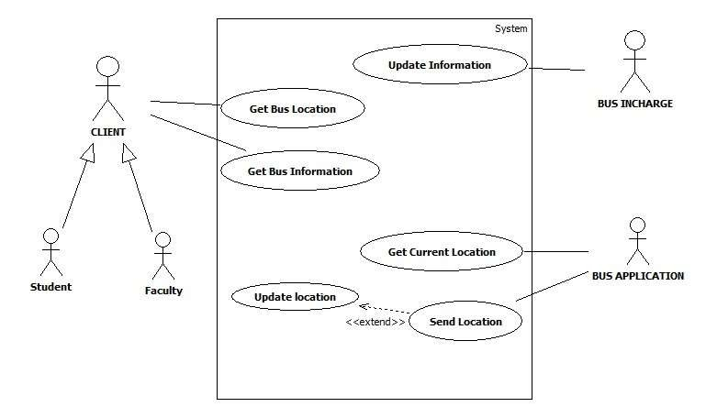
Use Case Diagram :

Slide 15
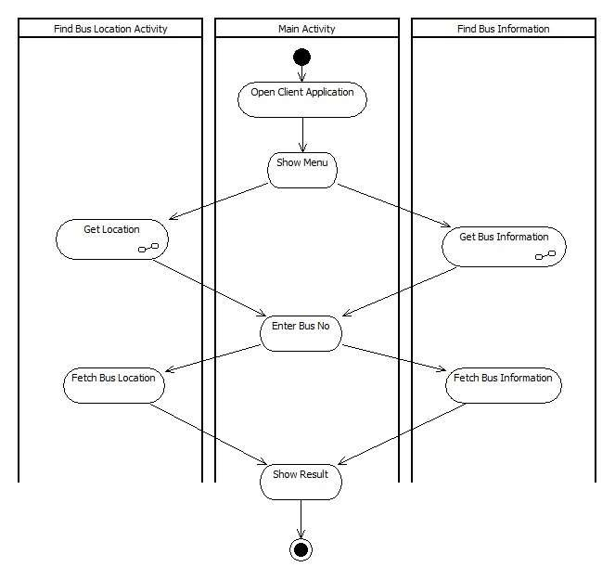
Activity Diagram :

Slide 16
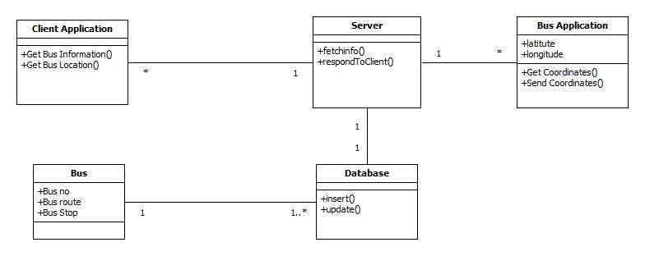
Class Diagram :

Slide 17
Conclusion:
Vehicle tracking systems are commonly used by fleet operators for fleet management functions such as fleet tracking, routing, dispatch, on-board information and security.
Vehicle tracking systems are also popular in consumer vehicles as a theft prevention and retrieval device. Police can simply follow the signal emitted by the tracking system and locate the stolen vehicle.
Asset tracking: Companies needing to track valuable assets for insurance.
Field service management: Companies with a field service workforce for services such as repair or maintenance, must be able to plan field workers’ time, schedule subsequent customer visits and be able to operate these departments efficiently.
Field sales: Mobile sales professionals can access real-time locations.

Slide 18


